Slide 1

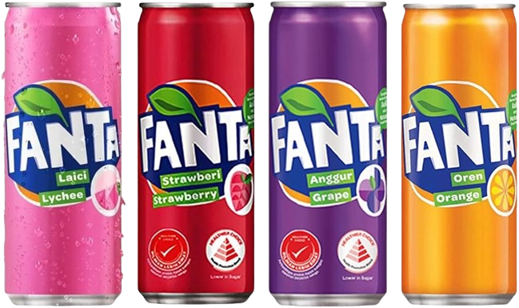
Embark on a flavor-filled adventure with Fanta,
Where every sip is a burst of fruity bliss!

Slide 2
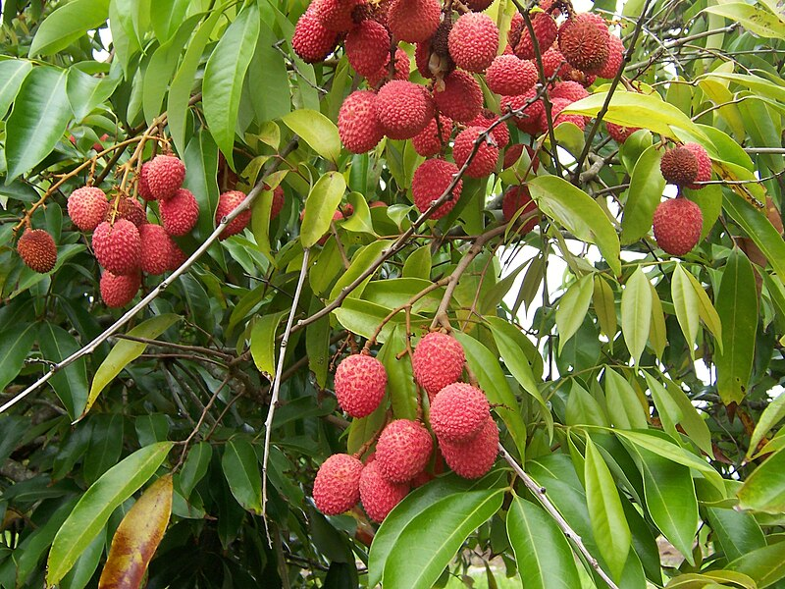
Lychee Fanta
Embark on a tantalizing journey with each sip of our Lychee Fanta. Let the exotic sweetness of lychee take your taste buds on a refreshing escape.
BUY NOW!!!

Slide 3
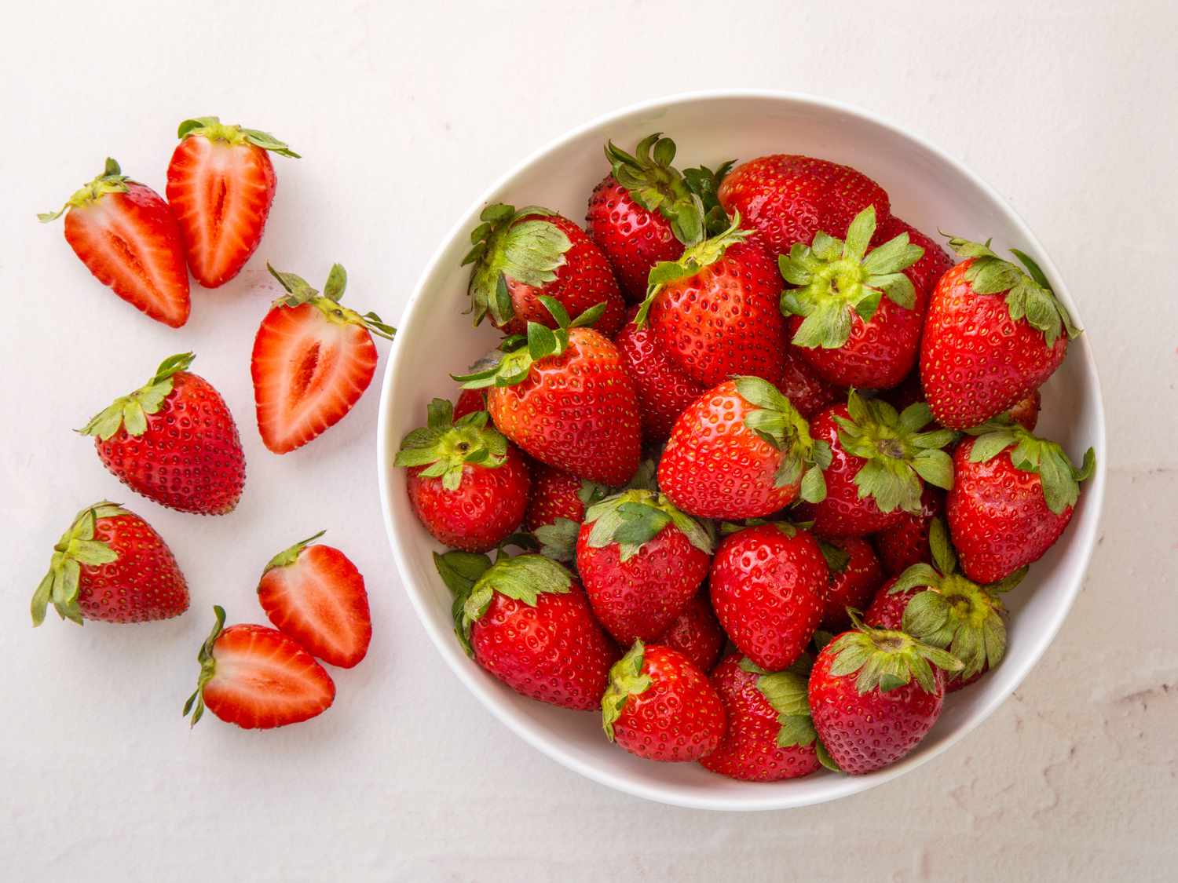
Strawberry Fanta
Bursting with the luscious flavor of ripe strawberries, our strawberry Fanta is a fruity delight that promises a sip of summer all year round.
BUY NOW!!!

Slide 4
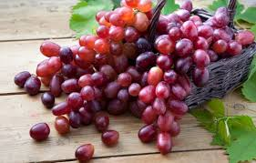
Grape Fanta
Indulge in the bold and juicy essence of grapes with every fizzy gulp of Grape Fanta. It’s a classic flavor that never fails to refresh.
BUY NOW!!!

Slide 5
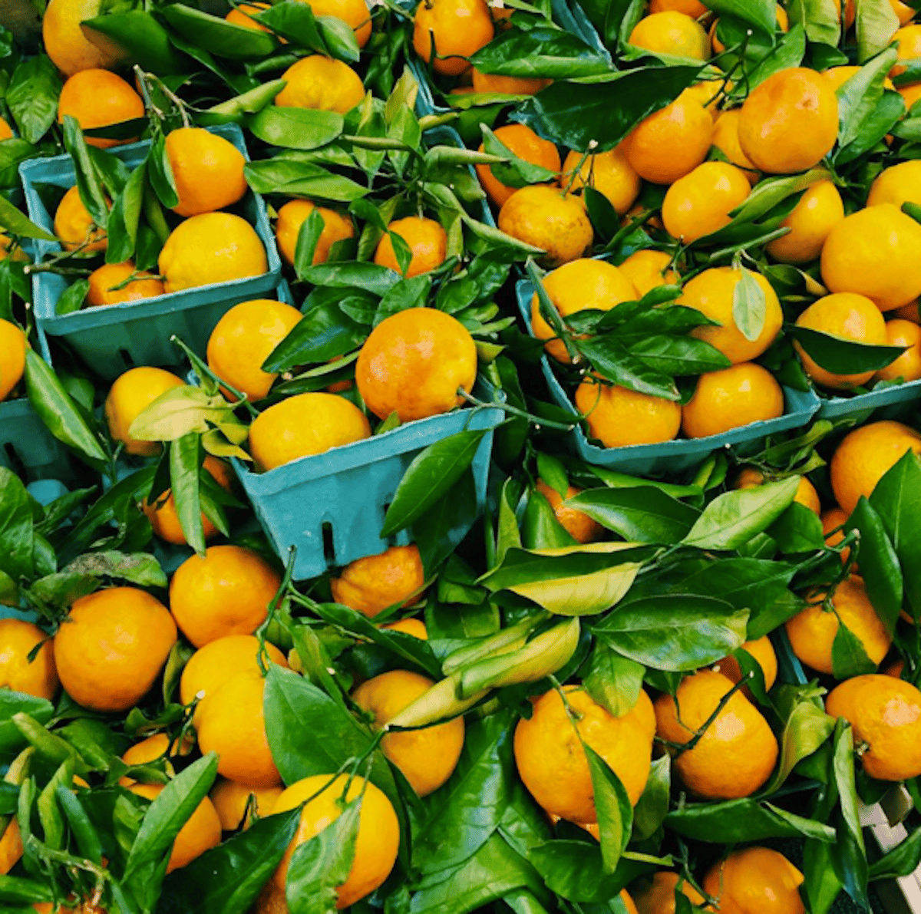
Orange Fanta
Dive into a citrus paradise with fresh Orange Fanta. With its zesty tang and bubbly effervescence, it’s the perfect pick-me-up for any occasion.
BUY NOW!!!

Slide 6
Refreshment Awaits With Fanta
Your ticket to a world of vibrant taste experiences. Dive into the fizz and fun today!

